Slide 1
Funding Assistant
Job Duties & Step by Step Guide

Slide 2
Job Duties
MERS
Post Fund CD’s
Post Close CD’s
Shipping
Closing Protection Letters
Fraud Guard
Lenders Instructions
Verification of Employment
Miscellaneous Items:
Cookie Report
CA per Diem Report
Verifying Doc Magic Report

Slide 3
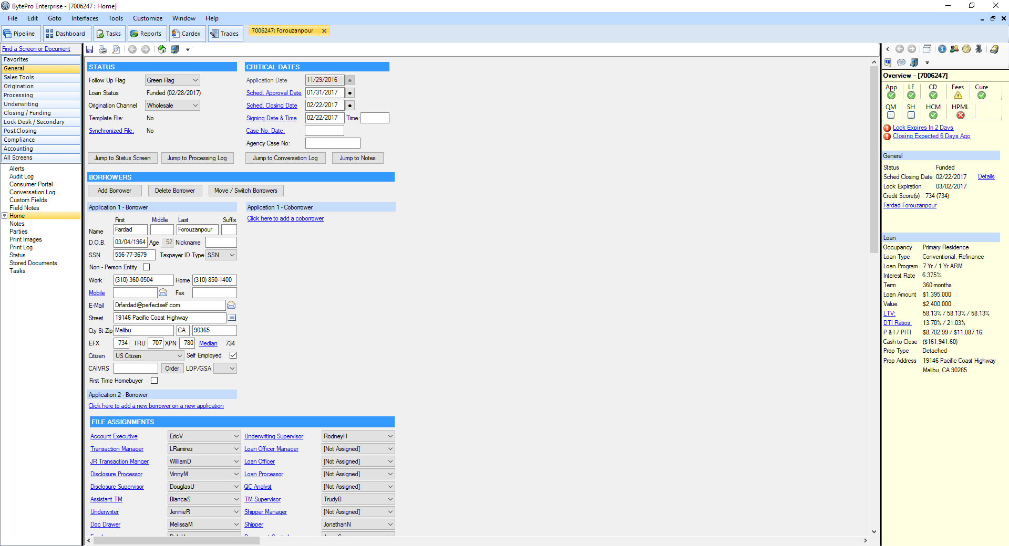
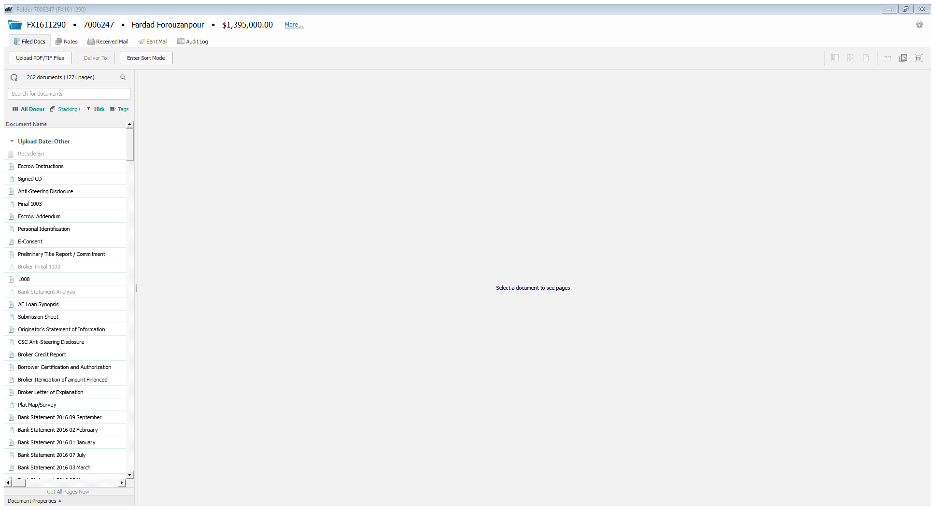
Shipping/Boarding
First, open the loan in DV And in Byte.
In DV, make sure the following are in the file
Closing Package
Final 1003
Signed CD
**please make sure that the Closing Instructions is on top of the closing Package. If it is not, enter sort mode and recycle CD.

Slide 4
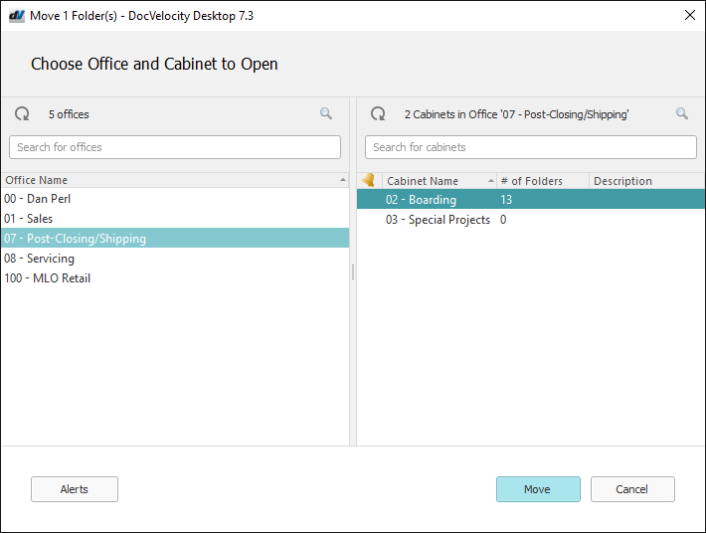
Shipping/Boarding
After everything is scanned in the file,
Right Click on the Loan in DV
Select Move
Post Closing/Shipping
And then Move in the bottom Corner

Slide 5
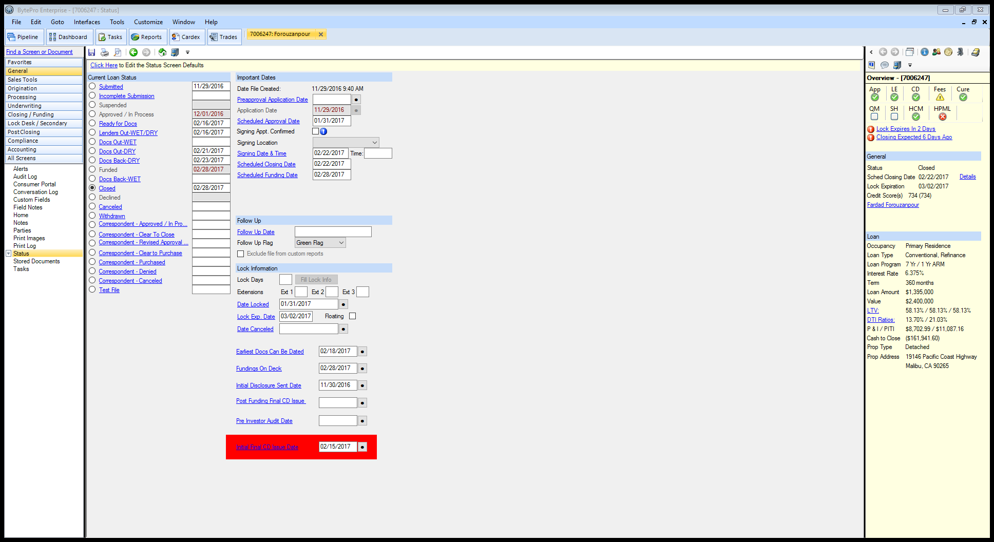
Shipping/Boarding
Go to Byte
Select General
Status
Then Select the small bubble near closed. This will automatically generate 4 separate emails. Send all.

Slide 6
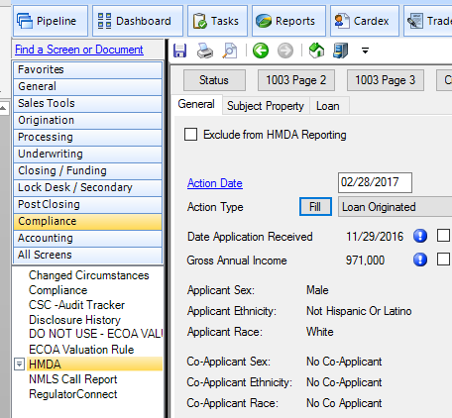
Shipping/Boarding HMDA Reporting
In Byte,
Go to Compliance
Then HMDA
When we ship, we are required to fill out the HMDA Reporting.
Select Action Date and Action Type
(See across)
**Sometimes the Government Monitoring information will not be selected. In that instance, in DV look at the original 1003 and plug in the borrower ethnicity in 1003 Page 2

Slide 7
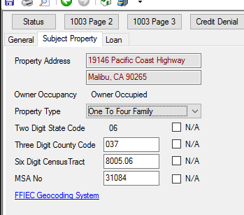
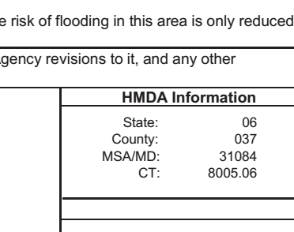
Shipping/Boarding HMDA Reporting
In Byte
On the subject property Tab
Visually check to make sure all items are filled out.
If the census is not filled out.
In DV go to the flood certification
In DV under Flood Certification

Slide 8
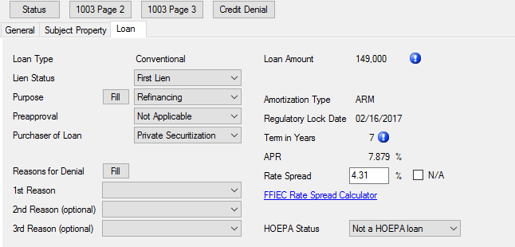
Shipping/Boarding HMDA Reporting
On the Loan Tab
Lien Status: If 700-1st Lien
If 800- Subordinate Lien
Purpose-
Either Purchase or Refinance
Preapproval-
Always Not Applicable
Purchaser of Loan-
Always Private Securitization

Slide 9
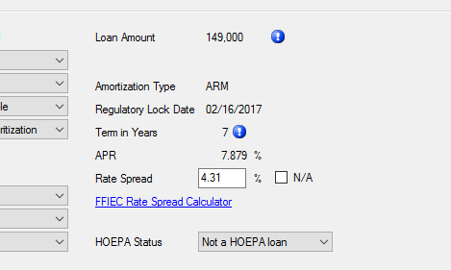
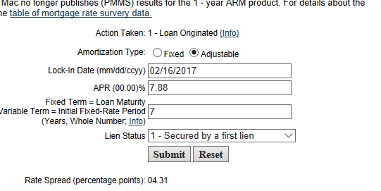
Shipping/Boarding HMDA Reporting
On the Loan Tab-
Select FFIEC Rate Spread Calculator –Shown in blue
This will take you to the Rate Spread Website. File out all the information. This information is found in Byte above the FFIEC Website Link. After you fill out all the necessary information Select Submit. This will populate the Rate Spread
HOEPA Status-Always Not a HOEPA loan

Slide 10
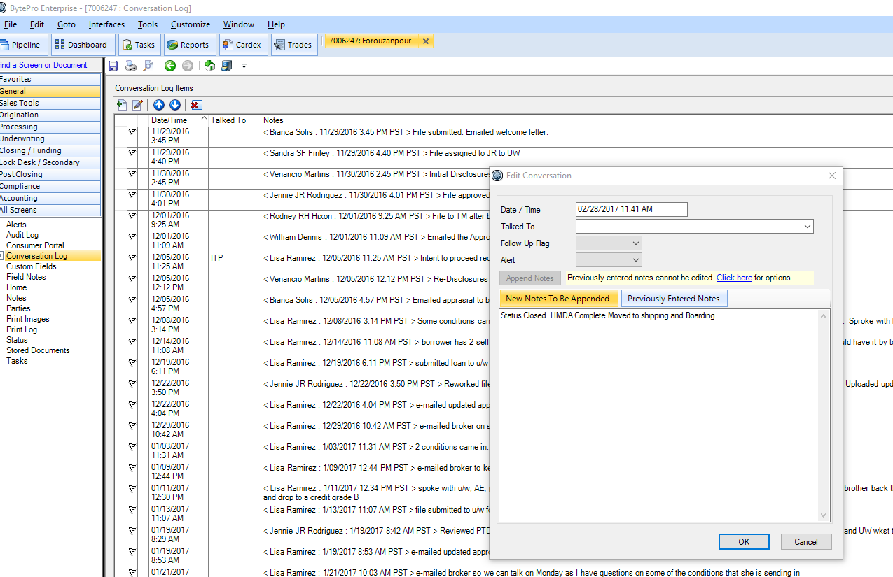
Shipping/Boarding
In Byte
Go to General and Conversation Log
Add Conversation
“Status Closed. HMDA Complete. Moved to shipping and Boarding.”
If the Post Funding Cd has been balanced
Clear the task

Slide 11
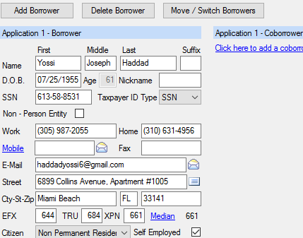
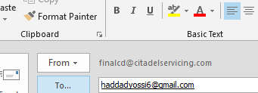
Post Fund CD
After a loan has funded, a Post CD is required to be sent to the borrower.
Pull up the loan in Byte
Select the Borrowers email address by selecting the envelope
This will immediately bring up outlook and an email. However, make sure you select from: FINALCD@CITADELSERVICING.COM

Slide 12
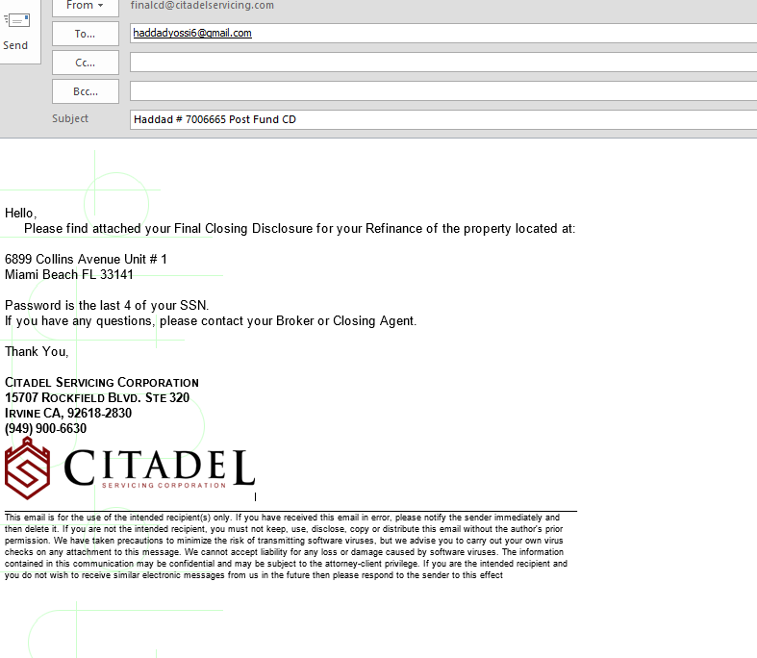
Post Fund CD
Subject: Customer Last Name; Loan Number; Post Fund CD
Body: (it is helpful to have this as a Signature line)
Update the information notated.
If two borrowers, make sure you note who the SSN of the Primary is. Example: In the body of the email you will have Password is the last 4 of your SSN (Robert).
If the borrower is a foreign national say: Password if the year of your birth.

Slide 13
Post Fund CD
In Byte, Go to Page 2 of the CD on the closing tab
Balance
Common Errors:
Title company adding a APR title fee (they need to remove)
Daily interest being off (they will need to fix)
Missing Cure

Slide 14
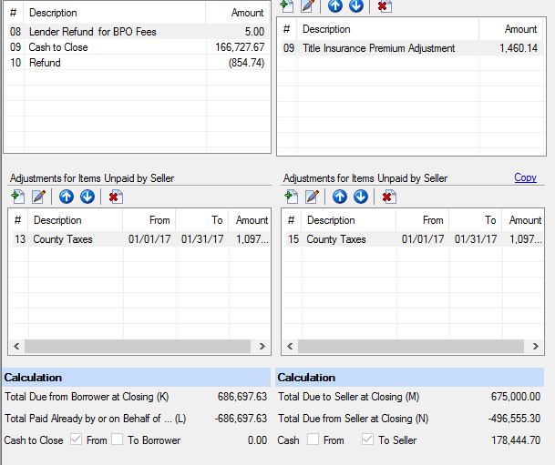
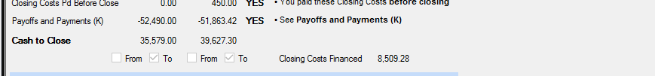
Post Fund CD
Purchases:
Borrower side should be Zero’d out.
Refinance :
Borrowers side should match final CD or settlement statement received from the settlement agent

Slide 15
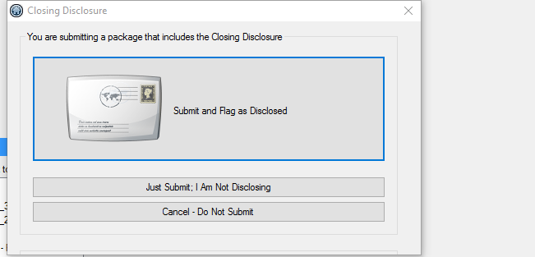
Post Fund CD
After Balancing, interface the loan by Closing/Funding
Doc Preparation
Submit
Select the Just Submit, I am not disclosing

Slide 16
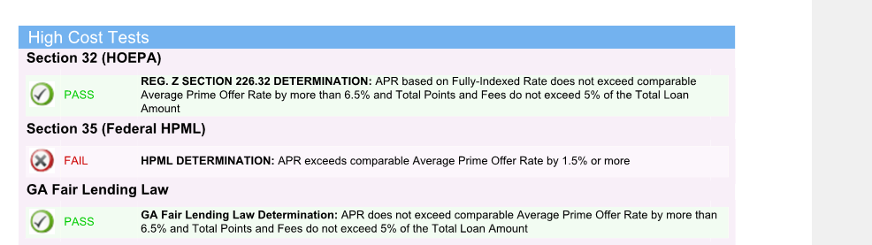
Post Fund CD
Open the Doc Magic interface document
Check the Federal High Cost Test (32) and the State High Cost Test
Compare the doc Magic APR to the APR on Byte.

Slide 17
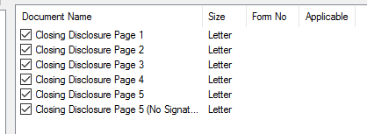
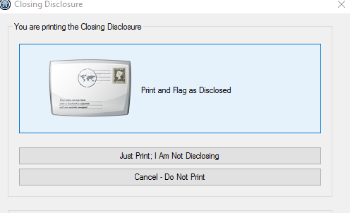
Post Fund CD
Go back to any page of the CD
Select Print
Unselect the No signature page
Select PDF
Do not Protect Documents with a Password
Rename: Post Fund CD
This time you will be disclosing to the customer, Hit PRINT AND FLAG AS DISCLOSED

Slide 18
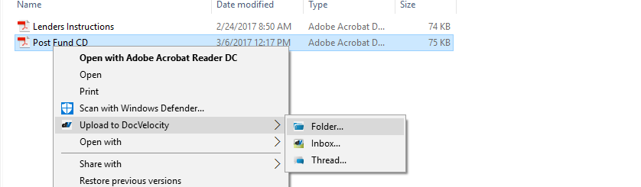
Post Fund CD
After you hit okay twice, this will bring up the PDF in a folder. Drag to the file cabinet and store new documents.
Right click and select upload to Doc Velocity
Look up loan number
Post fund CD tab over and say sent to the borrower on x/x

Slide 19
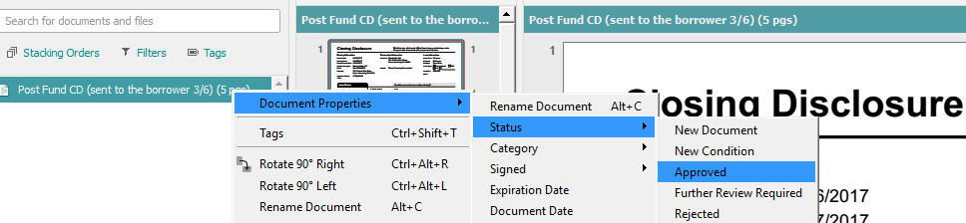
Post Fund CD
After you have named the file,
Double click
Document properties
Status
Approved
You will approve anything to do with a Closing disclosure. The Post fund CDs as well as the proof of cd sent.

Slide 20
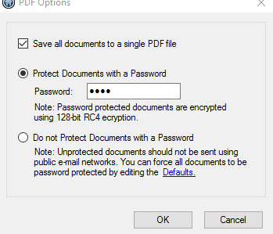
Post Fund CD
Go back to your file Cabinet in Byte
Select the Post fund CD
Export as PDF
This time, you will select the protect Documents with a password
Password will be the last 4 of the borrowers social
Or the year of their birth for a foreign national.

Slide 21
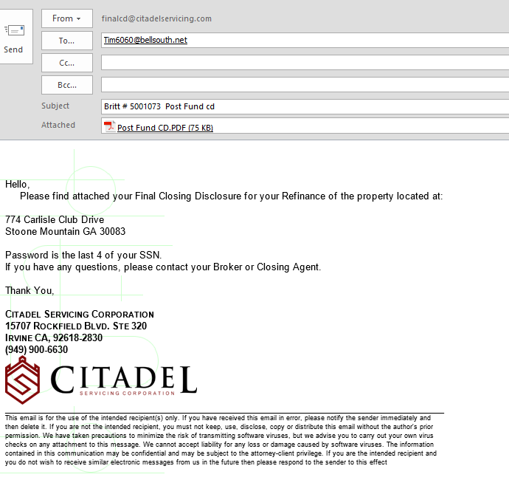
Post Fund CD
Drag your password protect document in your already completed email.
Double check to make sure it is coming from final CD email address.
Select send.
After you send, go to the sent items and upload the email to DV naming it Proof of Cd sent.
Tab over “Post Fund CD”
Remember to Approve this document.

Slide 22
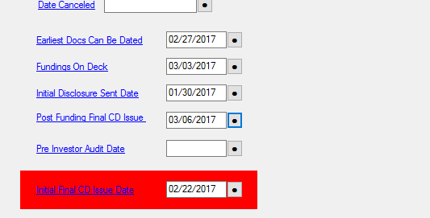
Post Fund CD
After you send the CD. In Byte go to
General
Then Status and select the Post Funding CD issue date:
Go to the conversation Log
“Post funding CD has been balanced and sent to the borrower.”
Clear Task if needed.

Slide 23
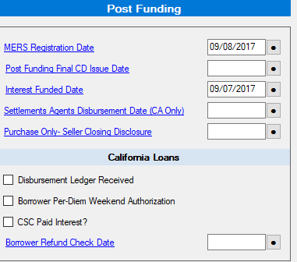
Post Fund CD-California
If the Property is located in CA, Go to CSC funding Screen to fill out the following:
Post Funding Final CD issued
Settlement agents Disbursement date – use the disbursement ledger
Disbursement Ledger Received
Also, upload the final settlement statement and Disbursement ledger to DV.
These dates will directly coordinate with the CA per Diem Report.

Slide 24
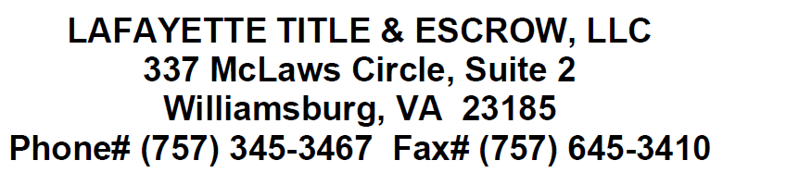

Closing Protection Letter Validations
After the Lenders Instructions are Sent, that is when the Funding Assistant gets tasked for CPL Validation and Fraud Guard.
Go to DV
Pull up Wiring Instructions and the Closing Protection Letter
**Right click on the document and hit open, that way you can compare Side by Side
We want to compare the Name and address on the wiring instructions (above) is the same on the Closing protection letter (below)

Slide 25
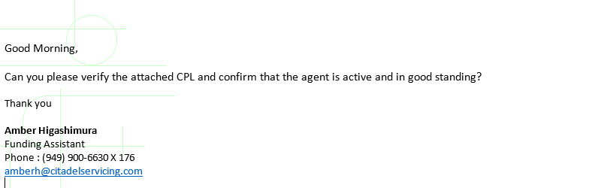
Closing Protection Letter Validations
Also, check the date. CPL’s are only good for 30 days.
There are several different title companies that can produce CPL’s. Each one has a different verification system. (see Word Document attached)
Example of an email (set this up as a signature)

Slide 26
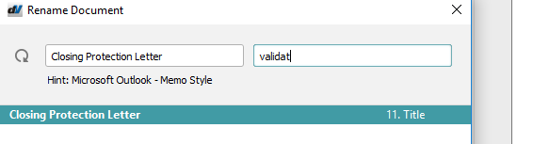
Closing Protection Letter Validations
After you have received either an email validation or a online validation
Upload verification to DV
Labeled
Closing protection Letter
Tab
Validation (and the date)
Also, go to the convo log and note “Closing protection letter is validated and uploaded to dv”
If fraud guard has been ran and no findings, this is when you can clear the task.

Slide 27
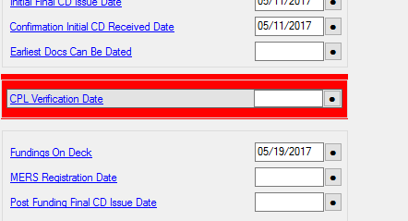
Closing Protection Letter Validation
After you have received the CPL Verification
In Byte: Go to CSC Funding Screen
Fill in date in which the CPL is verified
Clear task if Fraud Guard has been ran and cleared

Slide 28
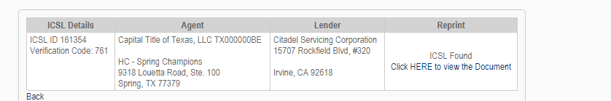
Closing Protection Letter Validations
If the website validations have a copy of the closing protection letter as well; upload that CPL into DV named:
Closing protection letter tab over and note that it is from the website
Select the Click here to view document and Verify all information on the CPL to make sure the one we have in the system is the correct CPL with the transaction.

Slide 29
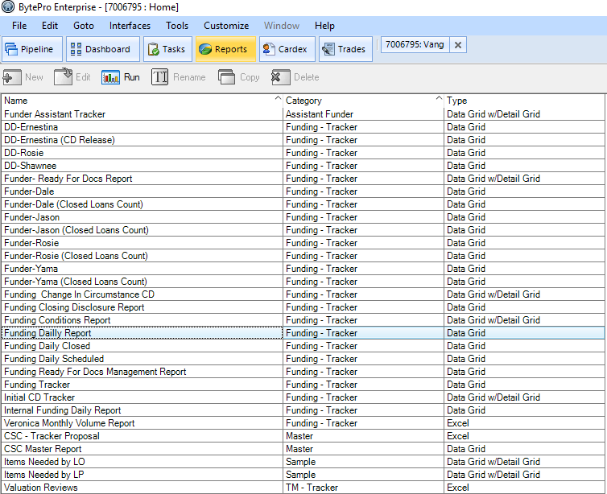
MERS
Log in to MERS and to Doc Magic. (have to use Internet Explorer for Doc Magic). Helpful to have them side my side on one screen and Byte on the other.
In Byte, pull up the funding daily report.
The date range will be the prior working day.

Slide 30
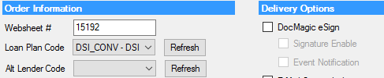
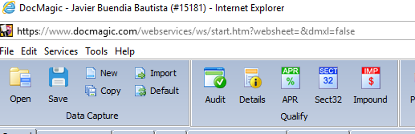
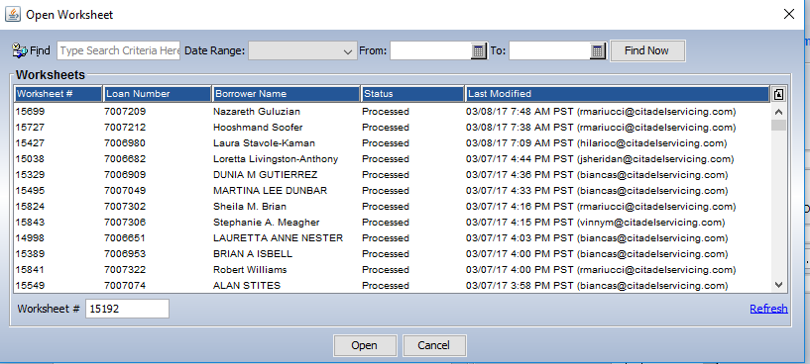
MERS
Pull up each loan in Byte.
Go to closing
Document Preparation
Take note of the Websheet Number in Byte
In Doc Magic Select Open
Copy the Websheet # from Byte to the Worksheet Number in Doc Magic
Then select Open

Slide 31
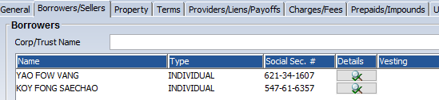
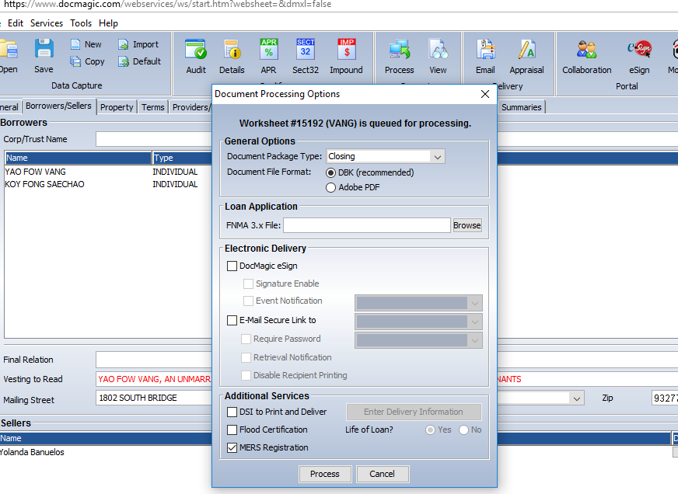
MERS
Go to the Borrowers Tab and visually confirm the borrowers name
Select Process
Click Mers Registration
And select Process again.

Slide 32
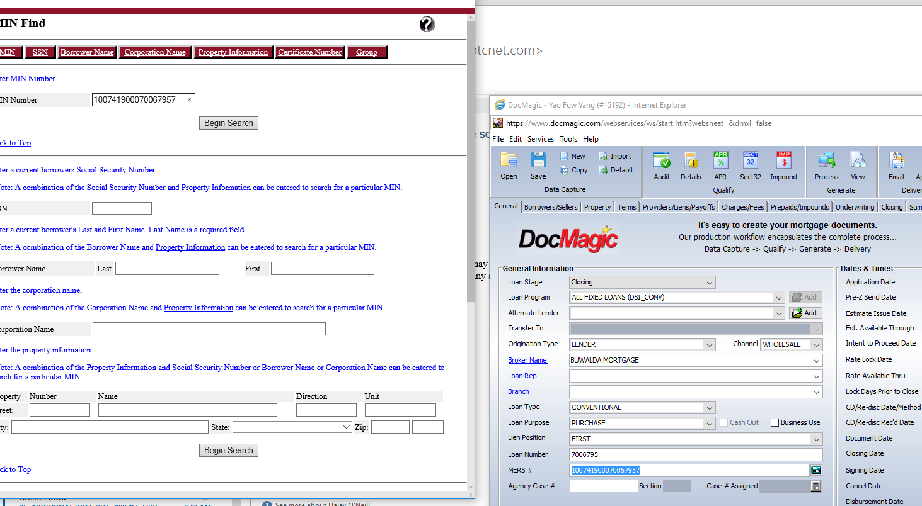
MERS
After you have processed the MERS registration
Copy the MERS number in Doc Magic to the MIN Number in MERS online System
Select Begin Search

Slide 33
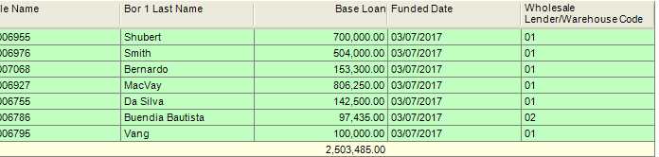
MERS
On the funding Daily Report, if the Wholesale Lender/Warehouse Code is 01 or 02: This is Silvergate.
If it is 06- Ameris
If it is Ameris you can upload the MERS registration after you hit Begin Search. Upload to DV, Document Name MERS.

Slide 34
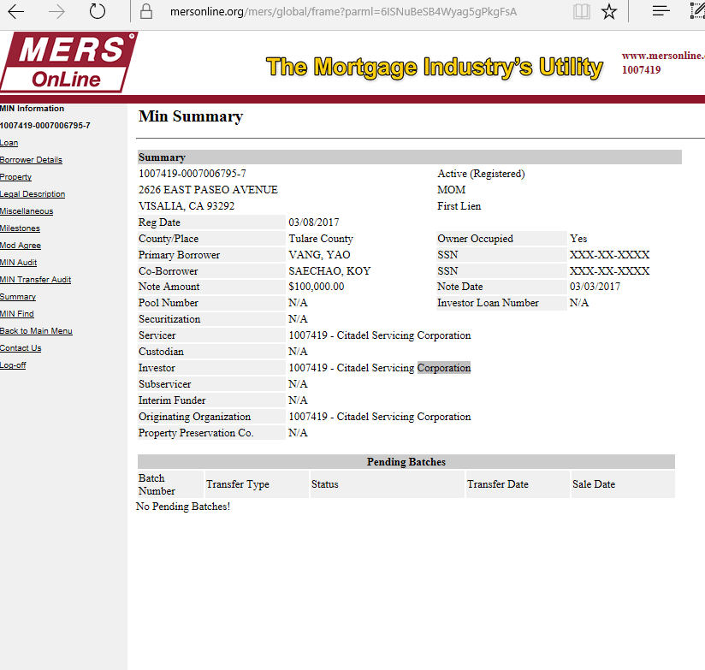
MERS
IF it is 01 or 02: then an additional step is needed.
On Mers Go to Loan in the left hand corner

Slide 35
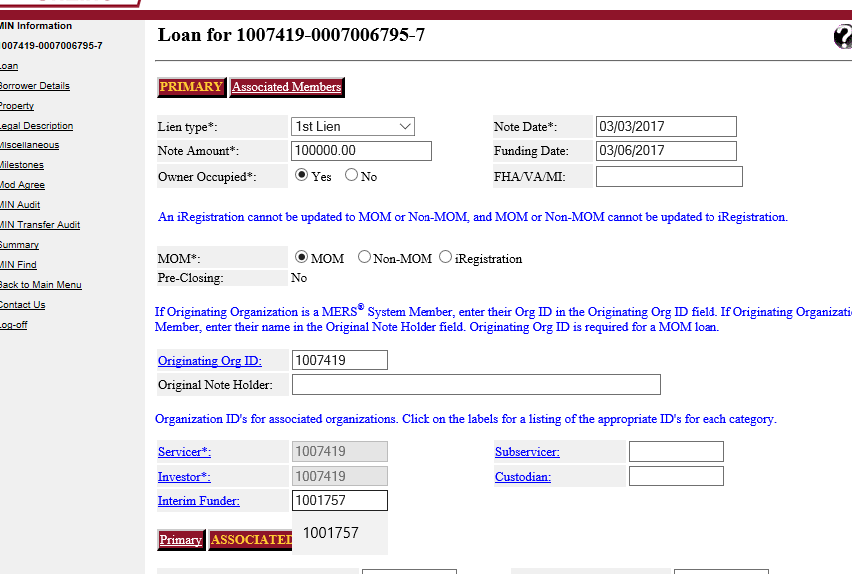
MERS
When it is Silvergate. You will add the Interim Funder of 1001757.
Scroll Down and select update

Slide 36
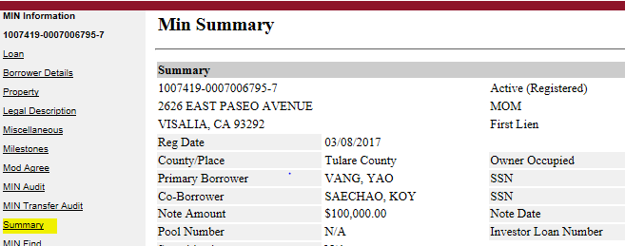
MERS
After you select update. Go to the left hand side and select Summary.
You will need to validate the information on the summery report. For example the property address, city, county, borrowers names, loan amounts, etc. This information should match everything in DV and in Byte.
Upload the summery into DV under MERS.

Slide 37
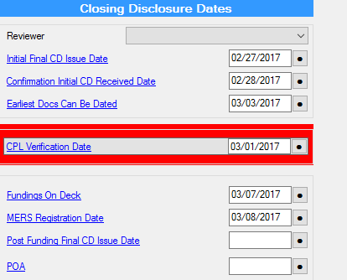
MERS
In Byte, go to the Closing Tab
CSC Funding Screen
Select the MERS Registration Date.
Note in the convo Log: Mers is completed and uploaded to dv.

Slide 38
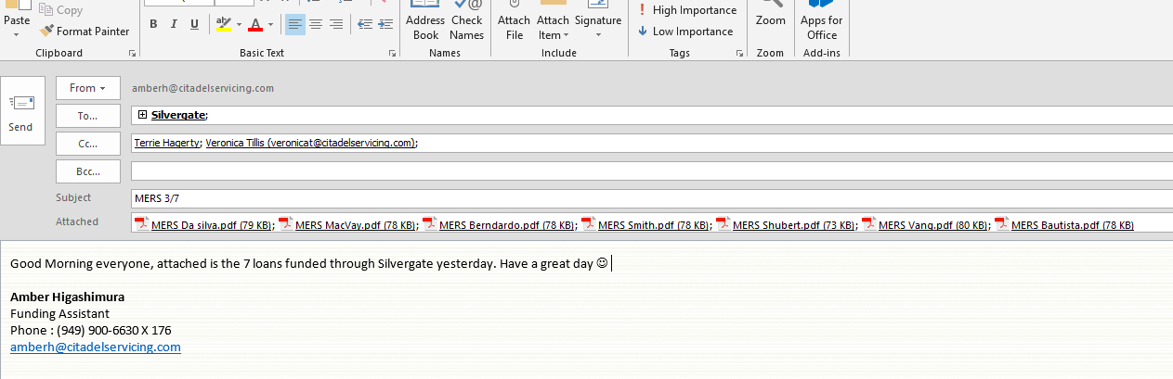

MERS
For each loan funded through Silvergate (Wholesale Lender Warehouse Code 01/02)
Go to DV Save each Mers Registration to your desktop.
Attach each loan to an outlook message
Email Silvergate (3 people) CC Veronica and Terrie.

Slide 39
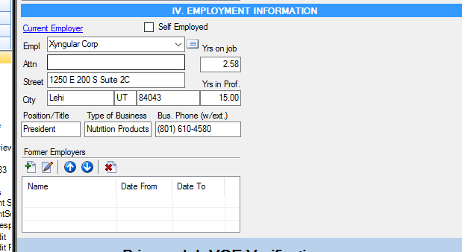
Verification of Employment
A VOE must be completed within 3 days (72hours) of loan consummation. (Self Employed and Foreign nationals, VOE’s are not required)
In Byte:
Go to origination
1003 Page 1
Call Number Listed (You may need to google the number to make sure you are not calling the borrower)

Slide 40
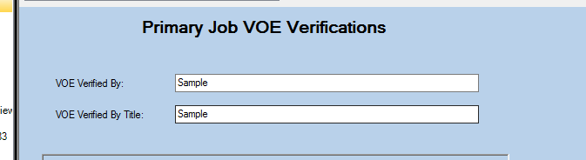
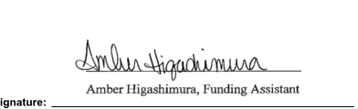
Verification of Employment
After you have received the Verbal Verification of Employment:
Fill out the information
Select the Print Button
Save it to the file cabinet (store)
Make sure you either wet sign it or use the Signing tool within the file cabinet. After you sign, upload to dv under CSC VOE and note in the convo log

Slide 41
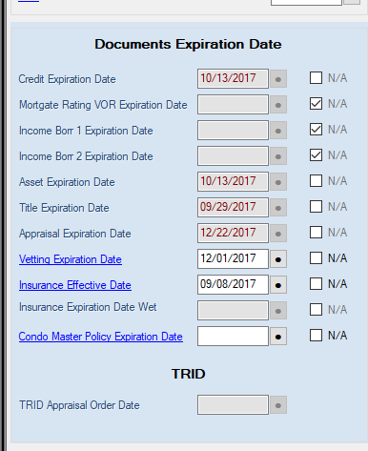
Lenders Instructions
Pull up Loan In Byte and Grab loan package.
Assign an Appropriate Funder By going to the Home Screen and selecting the funders name
Make sure you make note in the Excel Sheet the funder and the loan doc associated with the file.
On the CSC funding screen, ensure all dates are over the 8 day requirement.

Slide 42
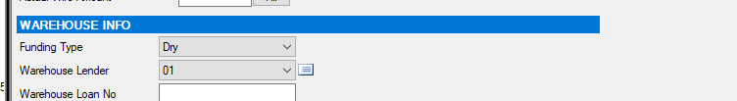
Lenders Instructions
Go to the Funding Screen: Indicate if the loan is wet or dry. All Owner Occupied Refinances plus Dry Purchase states will be Dry.
If Loan Is a Mag or NP- the Warehouse Lender will be a 1; If it is an ODF the warehouse Lender will be a 2

Slide 43
Lenders Instructions
Cut Off Times:
Wet States:12:00
Dry States: 3:00
This is whether the CD is sent or the file gets pushed over beyond those times.
Example: CD was sent on a Florida loan at 10:00 but wasn’t pushed over ready for docs until 12:30, this file is pushed to the next day

Slide 44
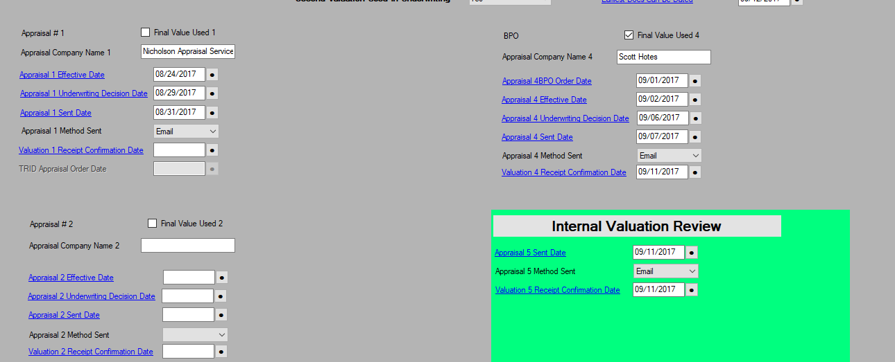
Lenders Instructions
Double check the ECOA Valuation that all appraisals have been sent to the borrower and confirmed if necessary. If unconfirmed, the first sign date will need to be updated.

Slide 45

Lenders Instructions
Go back to the Status Screen, Select lenders out – Wet/Dry. This will automatically generate an email to the Doc Drawer for the confirmation of the CD. Send the email.
If the signing date and Funding date is fine, move forward to the file cabinet. If not, then change the funding and signing date, update the funding's on deck, Page 2 of the CD interest, and re-interface the loan .

Slide 46

Lenders Instructions
Go to the File Cabinet . Select the c Documents that you need, Select New, and then Create New Document(s) based on Selected Documents

Slide 47

Lenders Instructions
Highlight the Lenders instructions. Usually about 5-6 Pages about 20 pages down.

Slide 48
Lenders Instructions
Rename Documents to Lenders instructions
Export Document as PDF with password.
Password will be the subject property zip code.

Slide 49

Lenders Instructions
The email for the Lenders Instructions
To: Settlement Agent
CC: Funder, Broker, AE, TM
BCC: Trudy, Veronica, and Dale Body of the email will be determined by the type of loan.

Slide 50

Lenders Instructions
After you split the documents and have you email ready to send
Go to tasks, Clear all Tasks. The Task that is TM- File Funding Ready for Docs. This will generate an email. Send the Email to the Funder and CC dale and Veronica. In the body select.

Slide 51

Lenders Instructions
After you send your emails, Create a new task. This will automatically send them an email .
Lastly, note in Byte “Lenders has been sent”

